Slide 1
Recommender Systems
Name: Liu Yang
Office: SHB802
Email: yangliu476730@yahoo.com

Slide 2
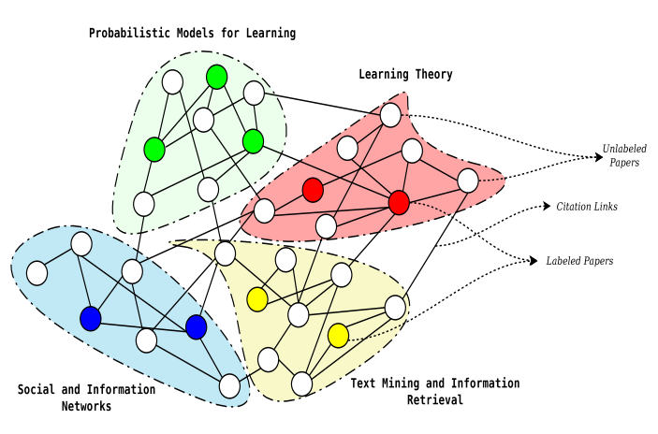
Example
Probabilistic Matrix Factorization is the winner of Netflix Challenge based on Netflix Matrix.
NETFLIX Rating
WTF: Who to Follow

Slide 3
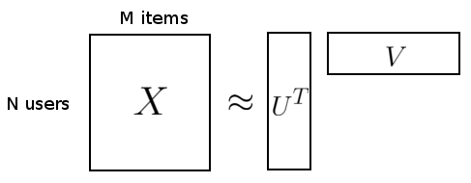
Notations-Probabilistic Matrix Factorization
Suppose we have M items, N users and integer rating values from 1 to D.
Let ijth entry of X, , be the rating of user i for item j .
is latent user feature matrix, denote the latent feature vector for user i .
is latent item feature matrix, denote the latent feature vector for item j .

Slide 4
Matrix Factorization: the Non-probabilistic View
Goal: To predict the rating given by user i to item j,
Intuition
The item feature vector can be viewed as the input.
The user feature vector can be viewed as the input.
The predicted rating is the output.
Unlike in linear regression, where inputs are given and weights are learned, we learn both the weights and the input by minimizing squared error.
The model is symmetric in items and users.
V_{kj}

Slide 5
Probabilistic Matrix Factorization
PMF is a simple probabilistic linear model with Gaussian observation noise.
Given the feature vectors for the user and the item, the distribution of the corresponding rating is:
The user and item feature vectors adopt zero-mean spherical Gaussian priors:
P
Notes:
Probabilistic matrix factorization (PMF). Unlike all of the other approaches with the exception of the matrix-factorization-based ones, PMF scales well to large datasets. Furthermore, unlike most of the existing algorithms, which have trouble making accurate predictions for users who have very few ratings, PMF performs well on very sparse and imbalanced datasets, such as the Netflix dataset.
Zero-mean spherical Gaussian priors on U and V: Each row of U is drawn from a multivariate Gaussian with mean μ=0 and precision which is some multiple of the identity matrix I (σ_{U} for U and σ_{V} for V).
Given small precision parameters, the priors on UU and VV ensure our latent variables do not grow too far from 0. This prevents overly strong user preferences and item factor compositions from being learned. This is commonly known as complexity control, where the complexity of the model here is measured by the magnitude of the latent variables. Controlling complexity like this helps prevent overfitting, which allows the model to generalize better for unseen data. We must also choose an appropriate αα value for the normal distribution for RR. So the challenge becomes choosing appropriate values for αUαU, αVαV, and αα.

Slide 6
Probabilistic Matrix Factorization
Maximum A Posterior (MAP): Maximize the log-posterior over user and item features with fixed hyper-parameters.
MAP is equivalent to minimizing the following objective function:
PMF objective function

Slide 7
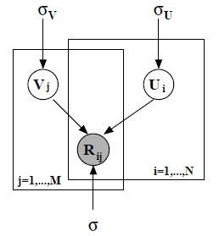
Probabilistic Matrix Factorization
PMF objective function
and is indicator of whether user i rated item j
First term is the sum-of-squared-error.
Second and third term are quadratic regularization term to avoid over-fitting problem.
Notes:
When the observation noise variance σ and the prior variances σ_{U} and σ_{V} are all kept fixed, maximizing the log posterior is equivalent to minimizing the sum-of-squared-errors objective function with quadratic regularization terms.

Slide 8
THANK YOU

