Slide 1
Label Propagation
Name: Liu Yang
Office: SHB803
Email: yangliu476730@yahoo.com

Slide 2
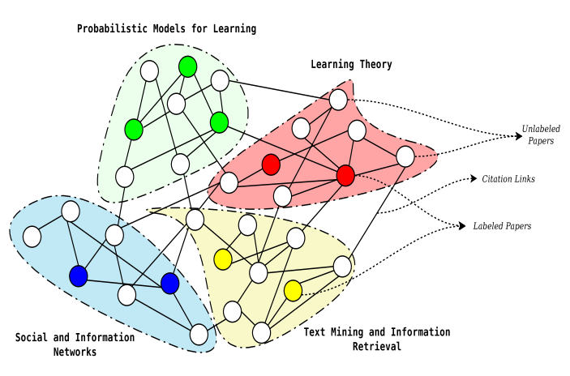
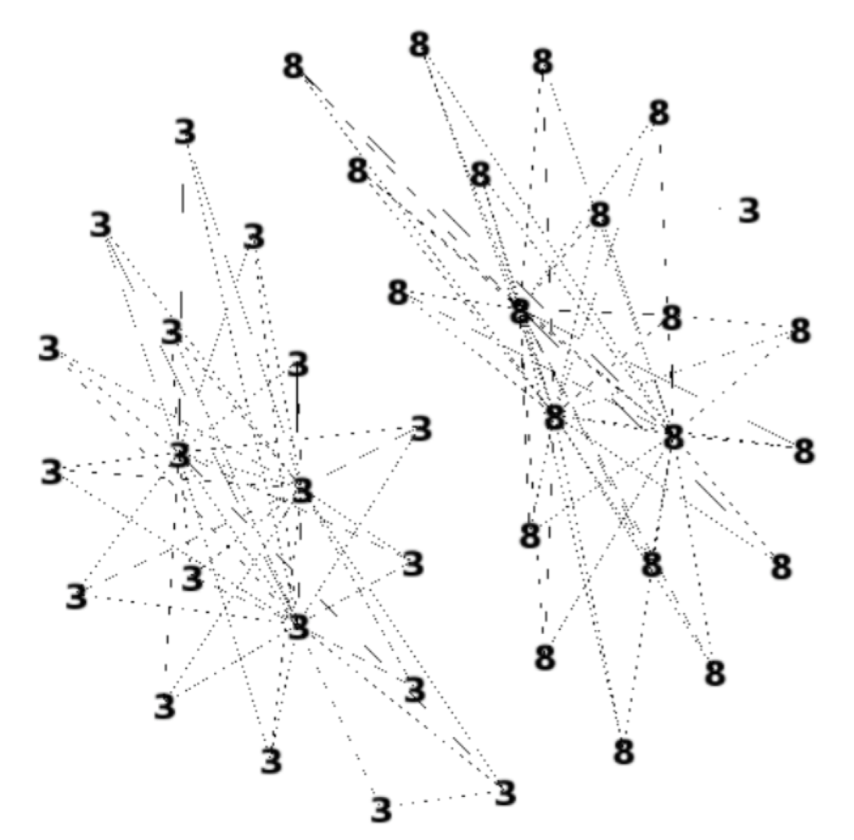
Example
Label Propagation is a semi-supervised method for community detection or classification. The goal of this method is to predict the label of unlabeled data.
Community Detection
Hand Written

Slide 3
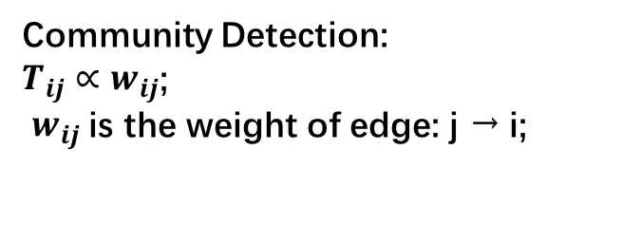
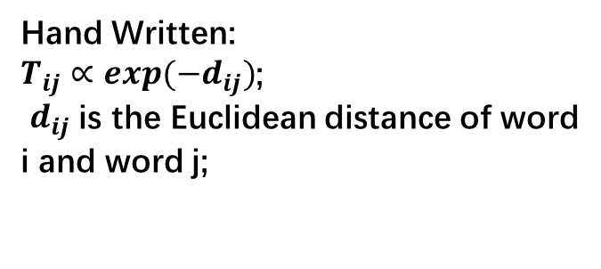
Definition
Let ${(x}_{1},$ $y_{1})……{(x}_{L}, y_{L})$be labeled data; ${ Y}_{L}=(y_{1},y_{2},……,y_{L})$ .
Let ${(x}_{L+1},$ $y_{L+1})……{(x}_{L+U}, y_{L+U})$be unlabeled data. ${ Y}_{U}=(y_{L+1},y_{L+2},……,y_{L+U})$ .
AND Y = $(Y_{L},Y_{U})$ .
Let $T_{ij}$ = P(j → i) be the probability that the label of $x_{i}$ is the same as $x_{j}$.
T is the probabilistic transition matrix.
Community Detection:
$T_{ij}∝w_{ij}$;
$w_{ij}$is the weight of edge: j → i;
Hand Written:
$T_{ij}∝{exp(−d}_{ij})$;
$d_{ij}$is the Euclidean distance of word i and word j;

Slide 4
Algorithm
The key idea of this algorithm is that the label of the data is the average
of its neighbor.
Propagate Y = TY
Row – normalize Y
Clamp the labeled data. Repeat from step 1 until Y converges
Tips: Y is in the softmax form

Slide 5
Convergence
This algorithm is converge to a single point. It guarantees the doable of this algorithm.
T need to be row – normalized.
3. All the element of T is small than 1.

Slide 6
THANK YOU

