Slide 1
The stratosphere platform for big data analytics
Alexander Alexandrov · Rico Bergmann · Stephan Ewen · Johann-Christoph Freytag · Fabian Hueske · Arvid Heise · Odej Kao · Marcus Leich · Ulf Leser · Volker Markl · Felix Naumann · Mathias Peters · Astrid Rheinländer · Matthias J. Sax · Sebastian Schelter · Mareike Höger · Kostas Tzoumas · Daniel Warneke
The VLDB Journal DOI 10.1007/s00778-014-0357-y

Slide 2
1 Introduction
Stratosphere includes a declarative query language
Stratosphere enables ‘in situ’ data analysis
Stratosphere uses a richer set of primitives than MapReduce
Stratosphere treats user-defined functions(UDFs) as a first-class citizens
Stratosphere includes a query optimizer that parallelizes and optimizes data analysis programs
Stratosphere supports iterative programming
Stratosphere uses an execution engine that includes external memory query processing algorithms and supports arbitrarily long programs shaped as DAGs.

Slide 3
1 Introduction
Stratosphere is a layered system that offers several programming abstractions
Meteor query language a declarative language for processing semi-structured data
PACT model, a generalization of the MapReduce model
Offers richer primitives and schema-less data processing interpreted by UDFs in Java
Especially useful for complex operators don’t fit in query languages
Nephele programming abstraction allows a power user to specify custom parallelization schemes

Slide 4
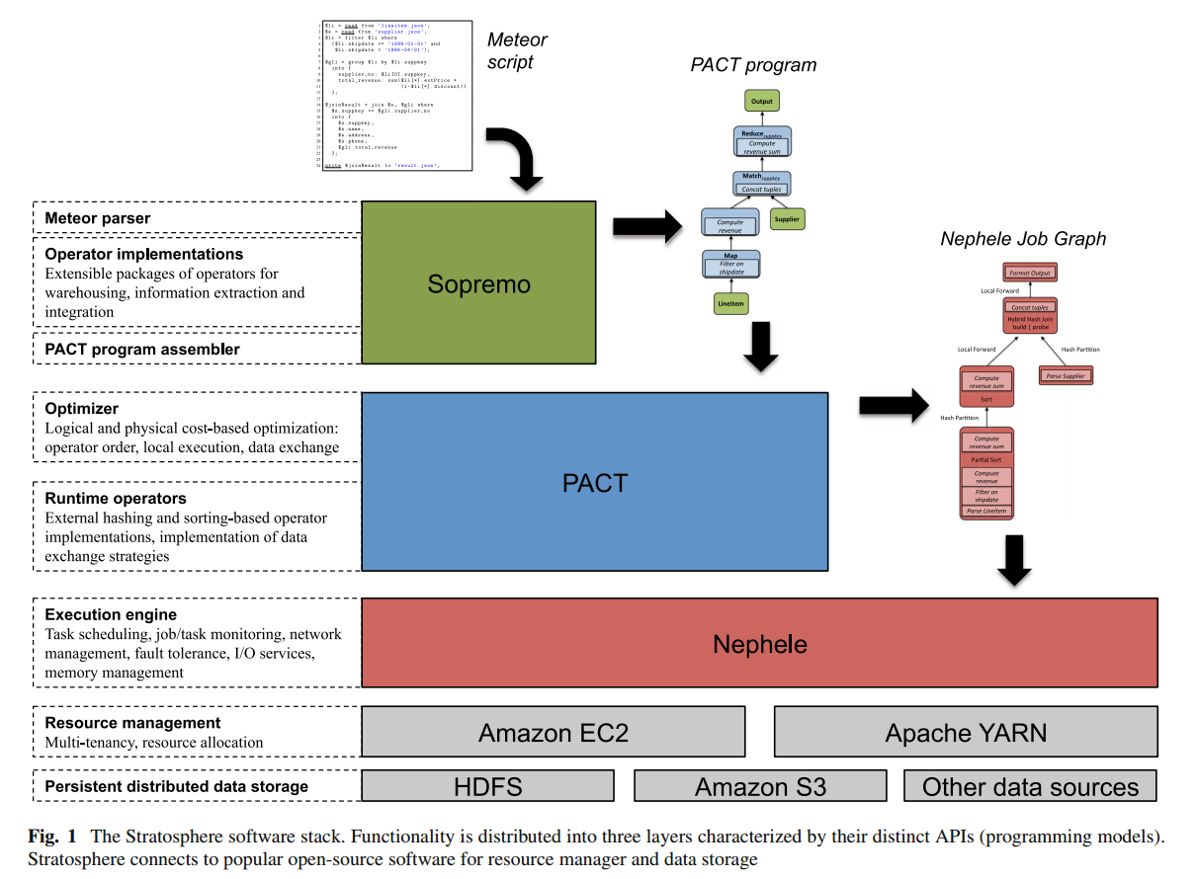
2 System architecture
Declarativity & expressiveness

Slide 5
2 System architecture
The introduction of a distinct layer that accepts arbitrarily complex DAGs of second-order functions that wrap arbitrary user code, and the ability to optimize such programs toward different physical execution strategies is one central aspect that differentiates the Stratosphere stack from other systems.

Slide 6
2 System architecture
Sopremo
A Sopremo program consists of logical operators connected in a DAG,
Written in Meteor script, a quey language that uses a JSON like data model to support processing semi-structured and unstructured data
Meteor is highlighted by extensibility and rich semantics
Automatic optimization at compile time
Meteor script ->Sopremo compiler -> operator plan
The compiler can also derive properties of the plan , later useful for optimization in PACT

Slide 7
2 System architecture
PACT
The output of Sopremo is the input to PACT layer
PACT programming model is built upon the idea of second-order functions, called PACTs
Each PACT provides a certain set of guarantees on what subsets of input data will be processed together
First-order function is invoked at runtime for each of the subsets
That way, UDFs can be written(generated) independently of parallelism or strategies for data shipping and reorganization
PACTs can be assembled to form arbitrary DAGs. Not just pipelines of jobs as MapReduce
PACT programs do not define how the used second-order functions will be enforced at runtime. E.g. Data partitioning, data shipping or grouping.
A special cost-based optimizer contained in the PACT layer, computes the alternative execution plans and choose the most preferable one
Info sources: code annotations, cluster’s resource manager, runtime statistics from previous jobs. Details discussed in Sects. 5 and 6.

Slide 8
2 System architecture
PACT Compiler’s output: a parallel data flow program for Nephele
Nephele: Stratosphere’s parallel execution engine
Nephele Data flow program(Job Graph)
Vertices: individual tasks
Edges: data flows
Contains a concrete execution strategy
Degree of parallelism for each vertex
Instructions on data partitioning
Co-location of vertices at runtime
During execution, Nephele can collect various statistics of each task
Stored inside Nephele’s master node
Can be accessed by PACT compiler to refine optimization for subsequent execution of the same task

Slide 9
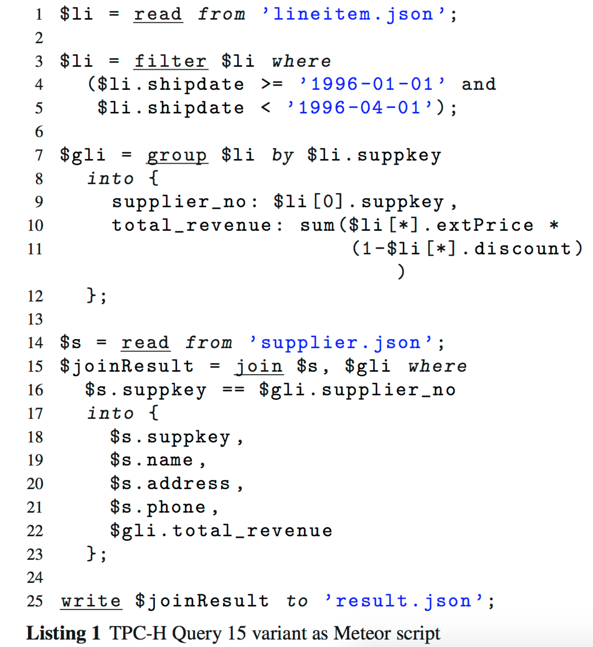
3 Meteor Examples
3.1 Structured data anlysis
‘$’ means a data set
Intermediate
Or materialized
Each operator invocation is followed by a list of inputs and a set of operator properties

Slide 10
3 Meteor Examples
3.2 Queries with domain specific operators
Given a set of employee records from the past five years and a corpus of news articles, we would like to find news articles that mention at least one former or present employee.

Slide 11
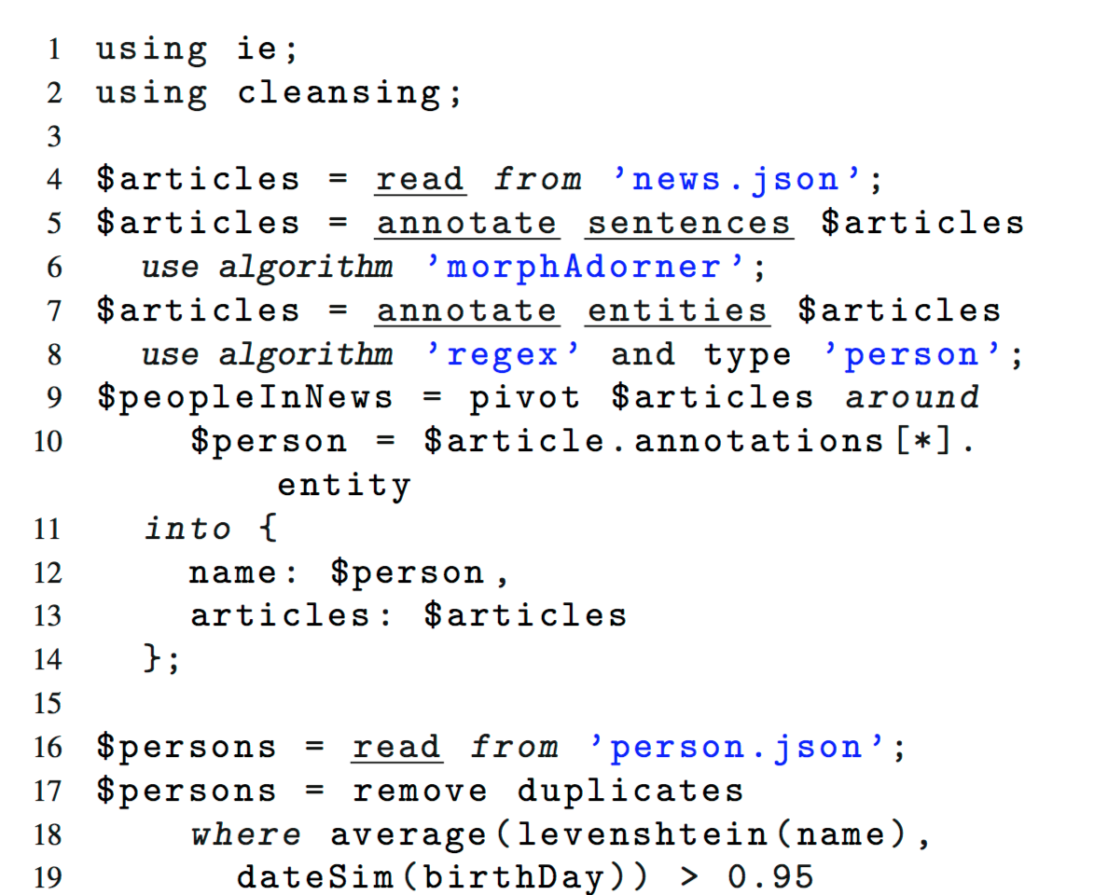
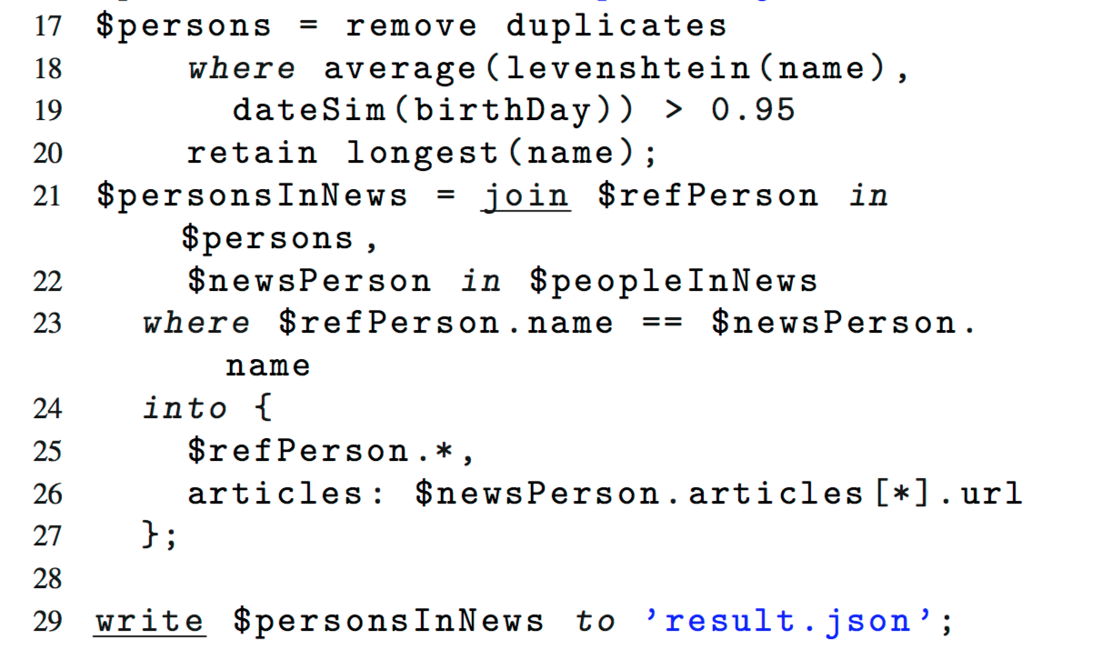

Slide 13
4 Extensibility in Stratosphere’s operator model
To seamlessly integrate domain-specific Sopremo packages, they must satisfy:
An operator can be defined either as a composition of other operators or as an elementary operator with a corresponding PACT program
Operator expose their properties through a reflective API. Operators may use the properties to choose an appropriate implementation. Thus no additional knowledges outside packages is required when configuring.
Package developers may provide relevant meta data to aid optimizer in plan transformation and cost estimation

Slide 14
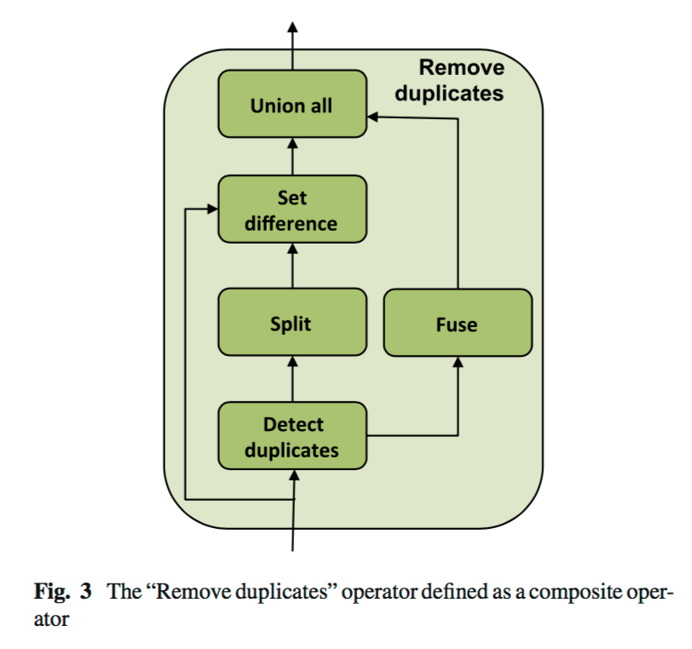
4 Extensibility in Stratosphere’s operator model
Operator composition
Enables code reuse
Allows complex operators to immediately benefit from more efficient implementations of simpler operators

Slide 15
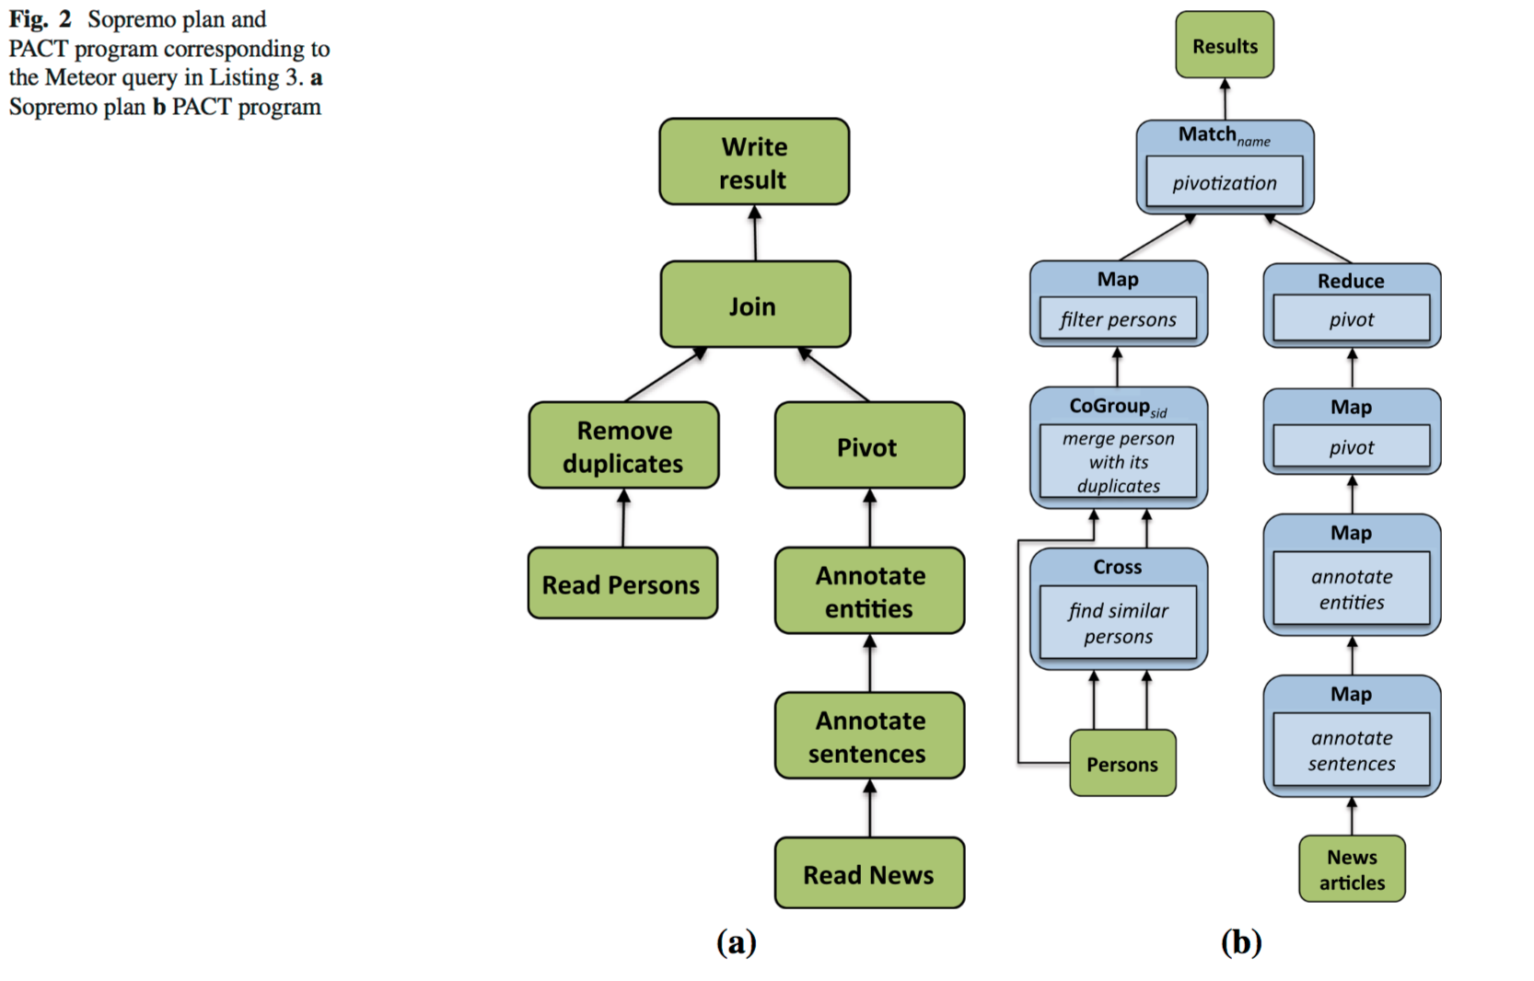
4 Extensibility in Stratosphere’s operator model
The Sopremo to PACT assembler translates each Sopremo operator into one or more PACT operators

Slide 16
5 Model for parallel programming
Data model
PACT operators operate on a flat record data model
A data set produced by one PACT operator and consumed by another is an unordered collection of records
A record is an ordered tuple of values
Nested Sopremo JSON objects are converted to records during the compilation of Sopremo plans to PACT programs. JSON nodes that act as keys are translated to individual record fields.

Slide 17
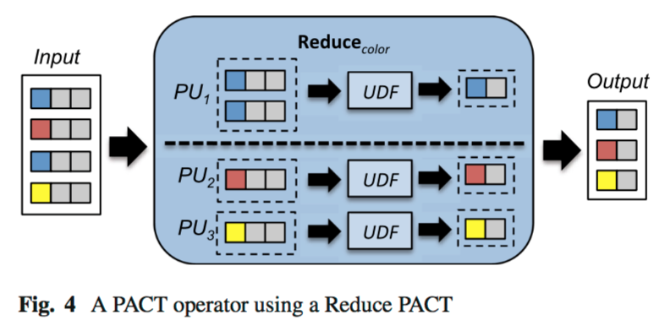
5 Model for parallel programming
PACT operators and acyclic PACT programs
A PACT is a second-order function that takes as argument a data set and a first-order user-defined function (UDF).
A PACT operator or simply operator consists of a PACT second-order function and a concrete instantiation of the UDF.
PACTs specify how the input data are partitioned into independent subsets called parallelization units (PUs).
Semantic information is encapsulated within the UDF logic and largely hidden from the system. While this may seem limiting, it enables the specification of a wider variety of data analysis programs (e. g., reduce functions that are not simple aggregates).

Slide 19
5 Model for parallel programming
Iterative PACT programs
Bulk iterations
In each superstep consumes the entire partial solution(result of previous superstep or the initial dataset)
Incremental Iterations
Split the representation of the partial solution to S(solution set) and W(work set)

Slide 20
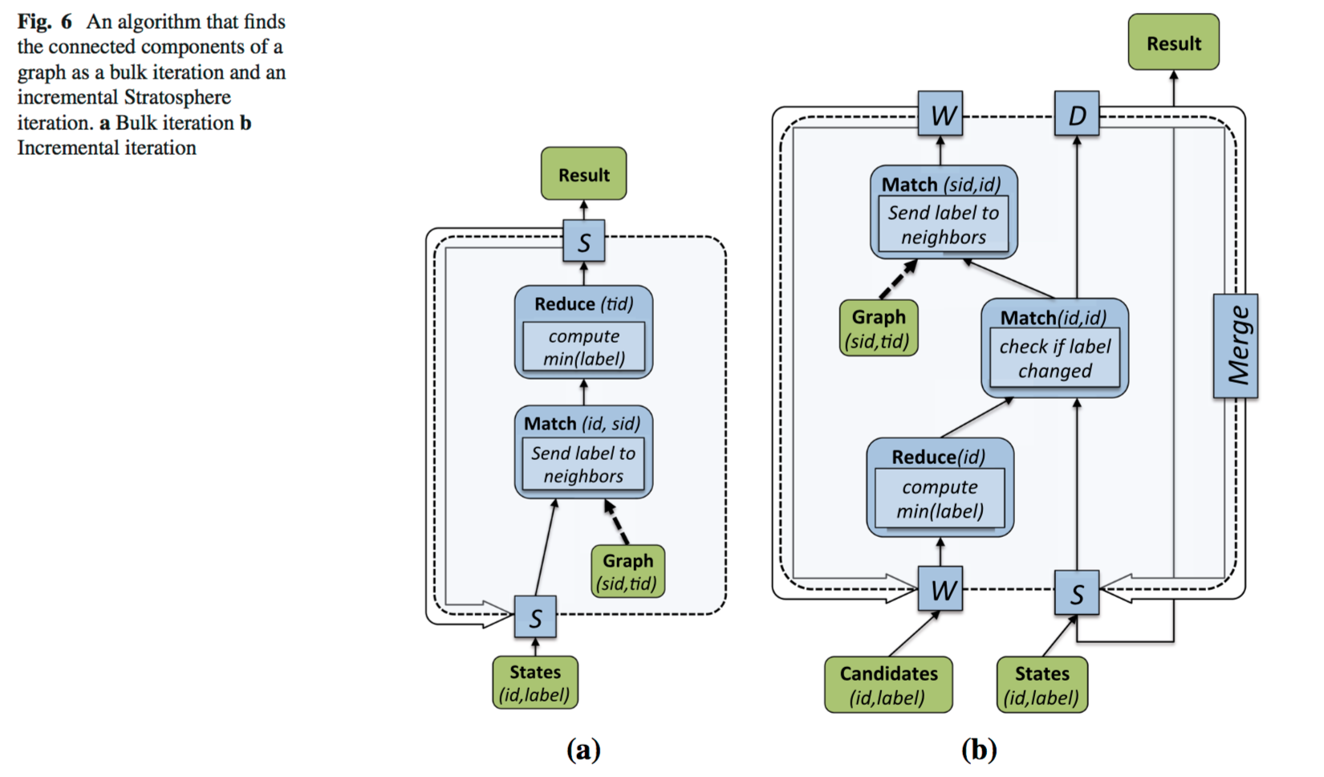
5 Model for parallel programming

Slide 21
6 Optimization in Stratosphere
The optimizer compiles PACT programs into Nephele Job Graphs
The Stratosphere optimizer build on technology from parallel database systems, such as
logical plan equivalence
Cost models
Interesting property reasoning
There are also aspects that clearly distinguish it from previous work
Originated from differences in program specification
Most relational database systems translated SQL into expression trees or relational algebra
PACT programs are DAGs of PACT operators
Semantics of a PACT programs are not in general known by the optimizer
The lack of semantics hinders the computation of estimates for intermediate results
To support a wide variety of use cases. Data is only interpreted by user code, hence opaque to the optimizer

Slide 22
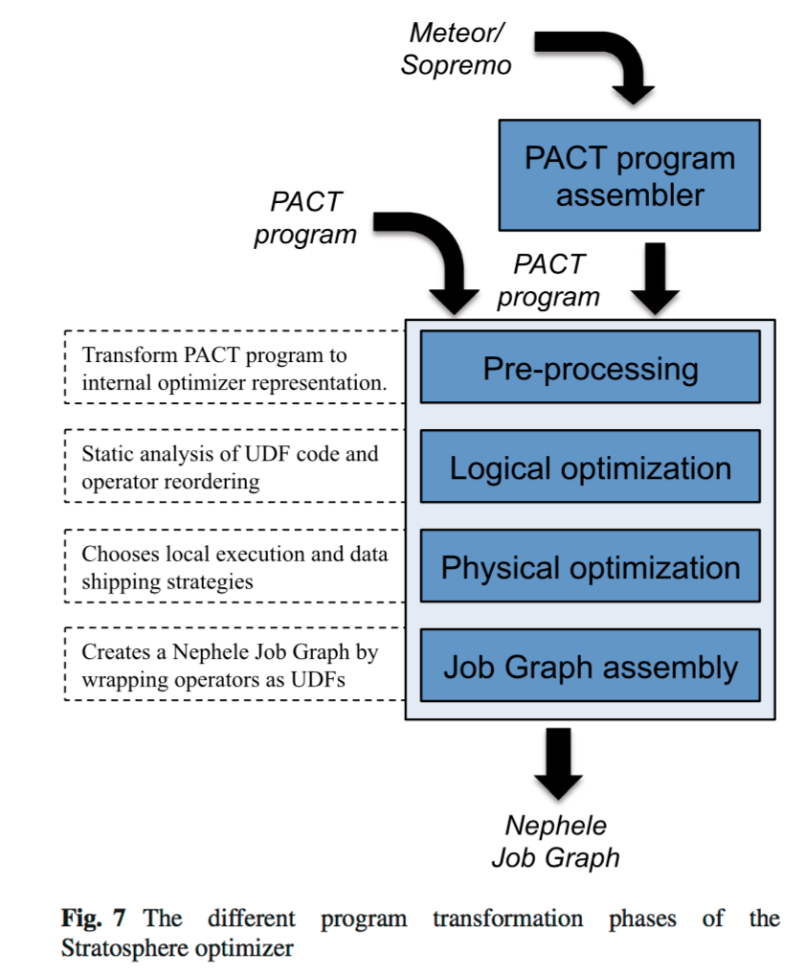

Slide 23
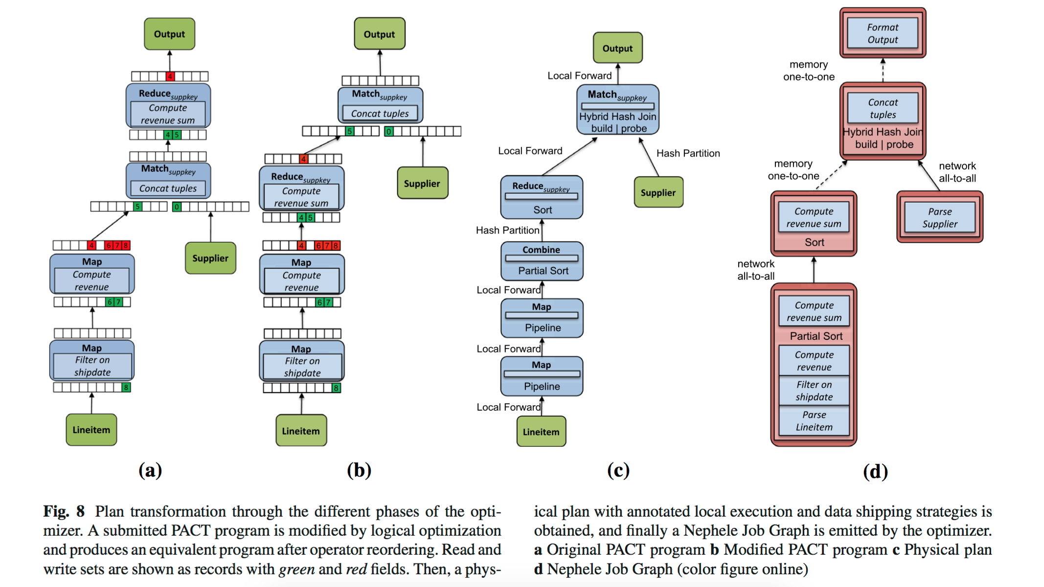

Slide 24
6.2 Operator reordering
Reorders operators similarly to logical optimization phase in realtional optimizers. Yet the rules cannot be applied due to the unknown semantics of UDFs.
Instead, we define and prove two sufficient condition to reorder two successive PACT operators.
Compares the read and write sets of 2 successive PACT operators and checks for over-lapping access patterns.
Evaluated to be true only when the read sets may intersect
Applies only for group base PACT operators, such as Reduce and CoGroup. Input groups are preserved if the operators are reordered.

Slide 25
6.2 Operator reordering
Employ static code analysis techniques to derive such information
Leverage our knowledge and control over the API user uses to access record fields. e.g., r.getField(1) to read field 1 from record r or r.setField(2,v) to write value v to r’s field 2.
The extraction algorithm uses control flow, Def-Use, and Use-Def data structures obtained from an SCA framework to trace the effects of record accesses through the UDF. Our approach guarantees correctness through conservatism. Field accesses can always be added to the corresponding read or write sets without loss of correctness (but with loss of optimization potential).
The optimizer may miss valid choices but will never produce incorrect transformations

Slide 26
6.3 Physical optimization
Concrete implementations of data shipping and local operator execution strategies using estimated execution costs
Stratosphere’s runtime supports
Repartition and broadcast data transfer and local execution strategies
Uses the concept of interesting properties
Optimizer keeps track of all physical data properties, e.g. sorting, grouping, partitioning
Not obvious whether UDF preserves or destroys the properties
The optimizer uses the notion of constant record fields, derived from Sect 6.2 e.g. Reduce doesn’t modify field 5 in fig 8.b

Slide 28
6.3 Physical optimization
The cost model is based on estimated network I/O and disk I/O
Challenging due to the focus on UDFs
Relies on hints
Set manually by users
Derived from upward layers
Enumerate physical plans base on depth-first graph traversal
Starting at the sink nodes, descending toward the sources
Generating physical plan when reaches the source on its way back to the sinks
For each subflow remembers the cheapest plan and all plan alternatives that provide interesting properties

Slide 29
6.3 Physical optimization
The compilation of iterative PACT programs features some specific optimization techniques
The optimizer classifies the edges of the data flow program as part of the dynamic or constant data path.
During plan enumeration, the costs of all operators on the dynamic data path are weighted with an user-specified number of iterations
The optimizer favors plans that perform much work within the constant data path. Subsequent to plan enumeration, the optimizer places a “Cache” operator at the intersection of constant and the dynamic data path.

Slide 30
6.3 Physical optimization
The cost model is based on estimated network I/O and disk I/O
Challenging due to the focus on UDFs
Relies on hints
Set manually by users
Derived from upward layers
Enumerate physical plans base on depth-first graph traversal
Starting at the sink nodes, descending toward the sources
Generating physical plan when reaches the source on its way back to the sinks
For each subflow remembers the cheapest plan and all plan alternatives that provide interesting properties

Slide 31
6.3 Physical optimization
Incremental Iterations
The elements of the solution set are identified by a key, and the set itself is stored partitioned and indexed by that key. An update of the solution set is realized by an equi- or outer-join with the delta set on the key. For this join, the partitioned index of the solution set can be exploited.
Furthermore, the optimizer can decide that the delta set is not materialized, and instead, the solution set is immediately updated.

Slide 32
7 Parallel dataflow execution
A program has been submitted to Stratosphere
A Meteor query,
A Sopremo plan,
A PACT program
A Nephele Job Graph
Submitted for execution to Nephele, Stratosphere’s distributed execution engine.
Classic Master/Worker pattern
Messages for tasks are bundled and pushed eagerly to reduce latency

Slide 33
7 Parallel dataflow execution
The Job Graph is a compact description of the executable parallel data flow. Each vertex represents a unit of sequential code, which is one or more pipelined data flow operators and/or UDFs.
In order to track the status of the parallel vertex and channel instances individually, the Job Manager spans the Job Graph to the Execution Graph, The Execution Graph contains a node for each parallel instance of a vertex, which we refer to as a task.

Slide 34
7.1 Tasks, channels and scheduling
A task is deployed together with all tasks that it communicates with through local pipelines.
The Job Manager deploys initially all input tasks with their local pipelines. All other tasks are deployed lazily.
The channels are typically pipelined through main memory or TCP streams
Channels may also transfer custom events. An event is a metadata message that can be sent both directions
Different compression algorithms for different scenarios

Slide 35
7.2 Fault Tolerance
Log-based rollback recovery
Materializes intermediate task results -> materializations points
Replays from the materialization points
O/W tracks back to the latest materialized result, which could possibly be the original input.
Materializes checkpoints “to the side” without breaking the pipeline
in contrast to the blocking operator model implemented by Spark, Hadoop and Dryad.
Copies the buffers containing the result data into a memory cache -> disk
Fully materialized as the blocking model when the last result was produced
Discards the checkpoint when writing checkpoints to a disk fail but result data has been forwarded
The system decides which results to materialize and which to stream
A Preselection can be done during optimization based on estimated results
Avoids big checkpoints, since reading from the disk is not significantly faster than recomputing.
When running low on memory resources, discards checkpoints when
Data volume = output buffers / input is large
Fast tasks i.e. can be efficiently recompute

Slide 36
7.3 Runtime operators
Goal: implement operators for data intensive processing in Java
Java’s downside: memory overhead & garbage collection
Solve memory overhead:
Designs runtime to work on serialized data in arrays rather than on objects
Arrays are lazily deserialized into objects when certain fields need to be accessed
Reuse the objects as much as possible to reduce pressure on garbage collection
Generalizes normalized keys and cache hash codes to allow byte-wise comparison agnostic to specific record layouts
Serialized data can be easily written to disk in case of memory pressure
How to map DAG of operators to execution plan
Naïvely, making each operator its own vertex -> each operator runs its own thread
Low CPU utilization or unnecessary context switches and synchronization
Put multiple operators into one vertex if they form a local pipeline

Slide 37
Normalized keys
Graefe, G.: Implementing sorting in database systems. ACM Comput. Surv. 38(3), Article ID 10 (2006)

Slide 38
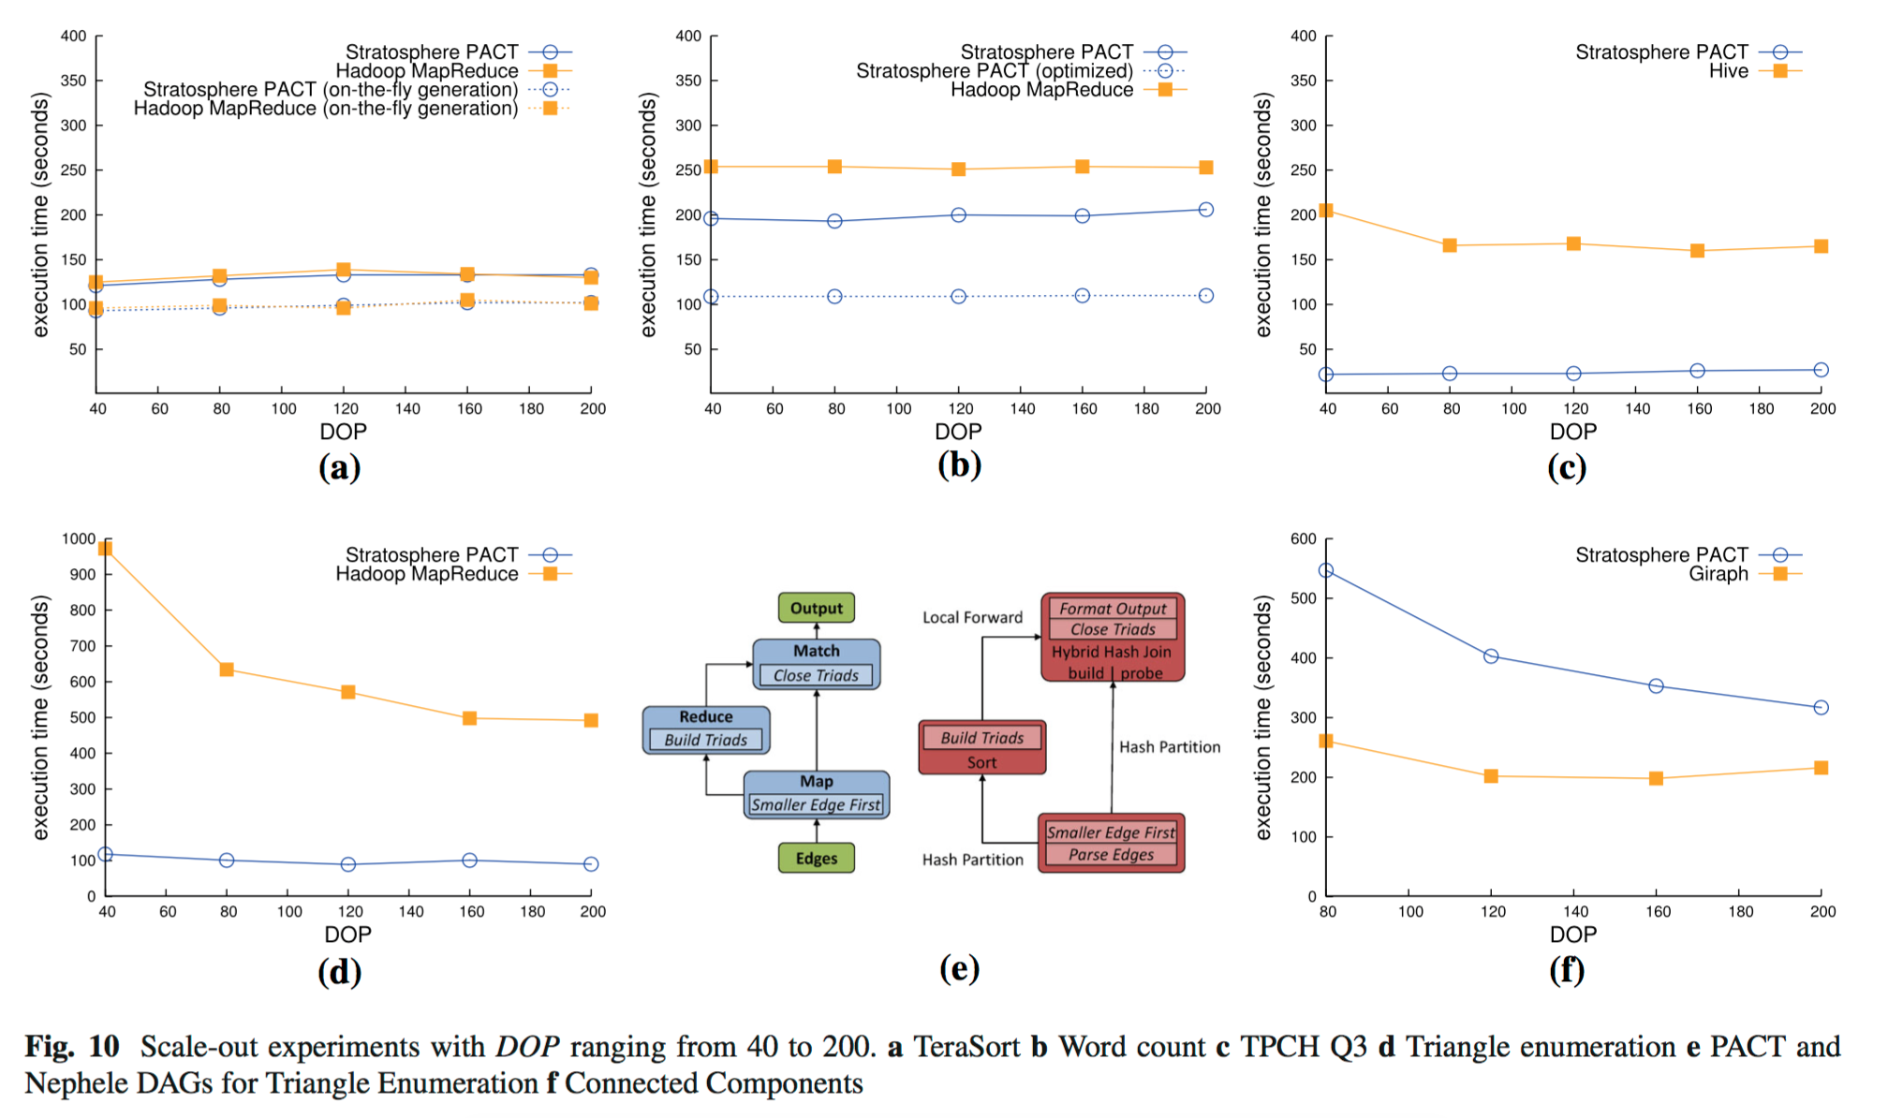
8 Experiments

Slide 39
8 Experiments
Results
The results in this section indicate that Stratosphere offers comparable or better performance against alternative open- source systems that provide general-purpose (Hadoop, Hive) or
domain-specific (Giraph) functionality
Explanations
Most of the gain can be attributed to execution layer features (e.g., eager push communication, different PACT implementations) and
The ability of Stratosphere’s optimizer to consider these features during plan enumeration in a cost-based manner.

Slide 40
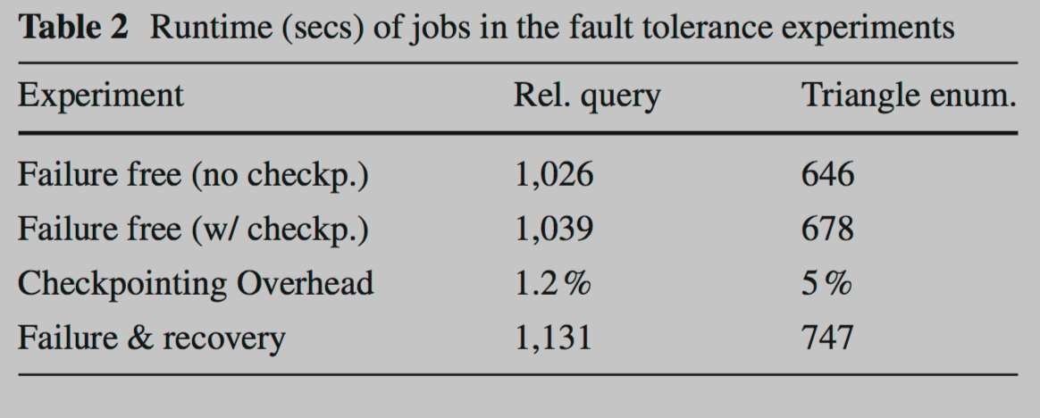

Slide 41
Ongoing work
To arrive at an one-pass optimizer that considers operator reordering and parallelization at the same time.
A module injects monitoring operators in the plan to collect statistics and report to a metadata store for optimization
Refine the cost model
Adapting plans at run time
Fault tolerant execution capabilities
Scalability and efficiency
Porting high level query or script languages on top of the query processor

Slide 42
Conclusion
A high-level scripting language, Meteor
Providing extensibility.
UDF-centric programming
Programs are optimized using a cost- based optimizer inspired by relational databases and adapted to a schema-less and UDF-heavy programming and data model.
Nephele provides scalable execution, scheduling, network data transfers, and fault tolerance.
Stratosphere occupies a sweet spot between MapReduce and relational databases. It offers declarative program specification; it covers a wide variety of data analysis tasks including iterative or recursive tasks; it operates directly on distributed file systems without requiring data loading; and it offers scalable execution on large clusters and in the cloud.

Slide 43
Future work
Revolving use cases that move beyond batch data processing and require fast data ingestion and low-latency data analysis

