Slide 1
MESOS

Slide 2
MESOS BEHAVIOR
Framework rampup time: time it takes a new framework to achieve all of its allocation( expectation of time or maximum time)
Job completion time: time it takes a job to complete, assuming one job per framework.
System utilization: total cluster utilization

Slide 3
ELASTIC & CONST: each task takes T to finish. The framework when allocated k slots at once, will take bT time to finish.
Ramp up time: At most after T time, all k slots will be available.
Compeletion time: When ramping up, on average kT/2 computation time is lost.

Slide 4
ELASTIC & EXP: each task takes T to finish. The framework when allocated k slots at once, will take bT time to finish. Before allocating, the slots originally has tasks running, the expecatation of finishing time is T and they follow k i.i.d of exp distribution.
Ramp up time: On avearge after Tlnk time, all k slots will be available.
Compeletion time: When ramping up, on average kT computation time is lost.

Slide 5
RIGID & CONST: each task takes T to finish. The framework when allocated k slots at once, will take bT time to finish.
Ramp up time: At most after T time, all k slots will be available.
Compeletion time: When ramping up, at most kT computation time is lost.
Utlization: Consider
actual total computation time/ total computation time when slots are busy

Slide 6
Compeletion time: When ramping up, at most kT computation time is lost.
Utlization: Consider
actual total computation time/ total computation time when slots are busy.
When ramping up, the average computation time wasted is kT/2

Slide 7
RIGID & EXP: each task takes T to finish. The framework when allocated k slots at once, will take bT time.
Compeletion time: When ramping up, on average Tlnk computation time is lost.
Utlization: Consider
actual total computation time/ total computation time when slots are busy

Slide 8
DOMINANT RESOURCE FAIRNESS

Slide 9
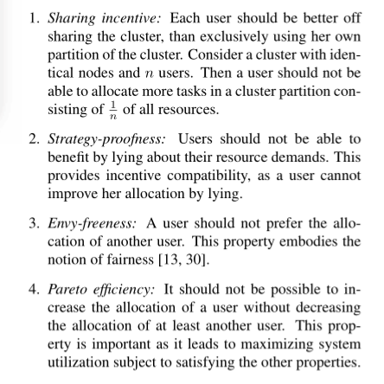
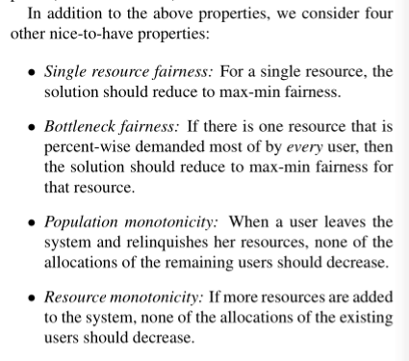
Important properties

Slide 10
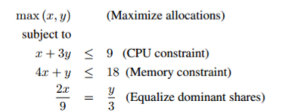
Dominant resource fairness
Fairness definiton: Consider a cluster with (9 CPU, 18GB RAM). Job A runs tasks with demand vector(1, 4), Job B runs tasks with demand vector(3, 1).

Slide 11
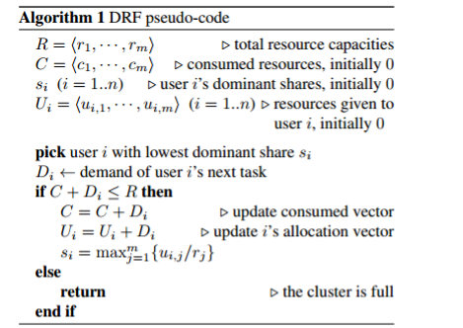

Slide 12
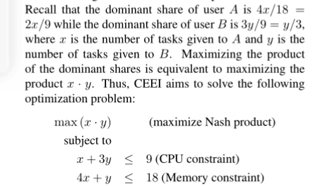
Comparison with other fair allocation policies
Asset fairness: 9 CPU, 18GB RAM. Then 1 CPU is worth $2, 1GB RAM is worth $1. Consider the same example jobs, Job A spends $6 each task, Job B spends $7 each tasks.
Competitive equilibrium from equal incomes:

Slide 13
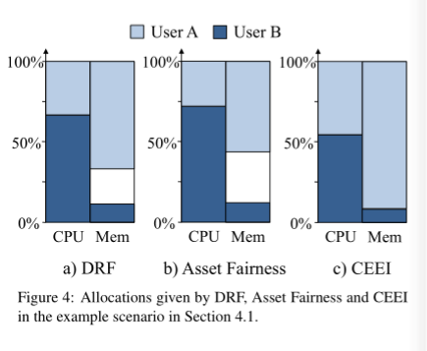
Result

Slide 14
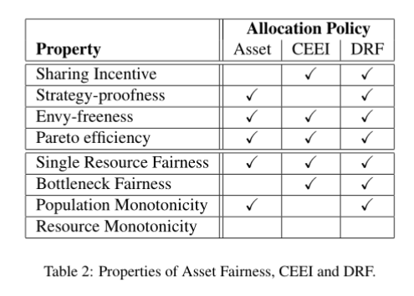
Analysis

