Slide 1
Kafka & Samza
Weize Sun

Slide 2
Keywords
Personalized Service
Stateful
Unix Philosophy

Slide 3
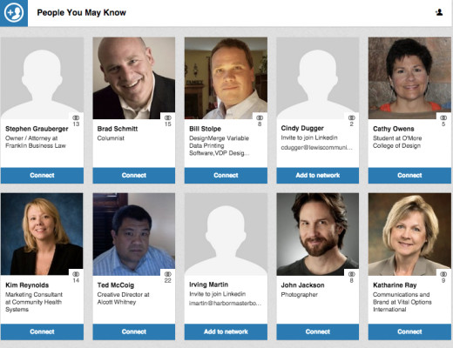
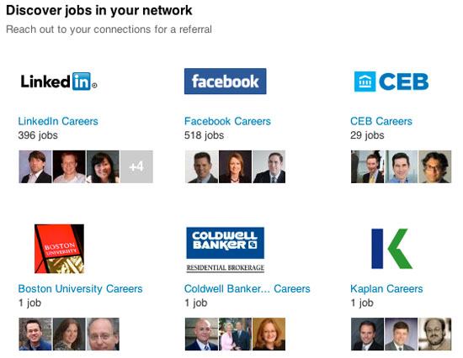
Why Personalized Service?
Respond at the first time,
Or you may lose customers.

Slide 4
What is Kafka and what is Samza?
Kafka provides a message broker service.
Samza provides a framework for processing message.
(Currently, Kafka also adds a feature called Kafka Streams to the Kafka client library, which is similar to Samza)

Slide 5
Kafka
Writing into partitions of topics only accepts append-mode, messages in partitions are totally ordered with offsets
Topics are divided into partitions(also called log)
Kafka provides a publish-subscribe messaging service
All the messages in logs are stored in disks

Slide 6
Kafka
Different Partitions are independent, even inside the same topic
Kafka provides a publish-subscribe messaging service
Consumer clients read messages sequentially
(the only way)

Slide 7
Kafka
Clients remember offsets to communicate with the topic and avoid crashing
Kafka provides a publish-subscribe messaging service
The work of consuming a topic can be shared among consumer groups

Slide 8
Kafka partitions
Assign replicas to different consumers
Partition replica 1
Partition replica 2
Partition replica 3
Once a leader dies, other replicas will be chosen as a new leader
Leader
Broker node 1
Broker node 2
Broker node 3
Copy the change to other replicas
Publisher write to leader

Slide 9
Scalability of Kafka– log compaction
Key 12
Key 23
…
…
TBC
Key 12
Usually there will be approximately 100 topic-partitions per broker node
Overwritten keys will be send to garbage collector
Latest keys will be kept for indefinite time

Slide 10
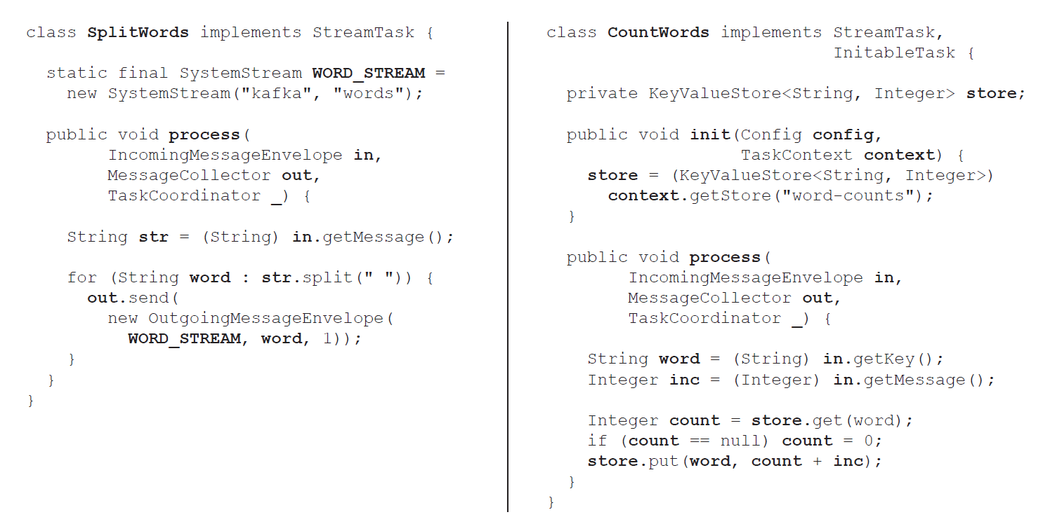
Samza
One StreamTask for each partition reading
Process interface responsible for message manipulation

Slide 11
Interaction between Samza & Kafka

Slide 12
State management of Samza
This data structure store the state
State management is designed to survive thread crash
Samza uses RockDB to provides low-latency access to disk.

Slide 13
State management of Samza
In case disk crashes, Samza also writes to a partition to Kafka to store the state

Slide 14
Advantage of Stateful system
Avoid system crash
Support stream join
Different streams can share information

Slide 15
Stream join of Samza
Window join: messages from input streams A and B
are matched if they have the same key, and occur within some time interval Δt of one another.
Assumption: A and B are partitioned in the same way
Partition 1
Partition 2
…
Partition k
Partition 1
Partition 2
…
Partition k
Partition 1
Partition 2
…
Partition k
Log compacted stream in StreamTask
Process in StreamTask

Slide 16
Shared information
Share information
People are interested in technology!
A listening Stream

Slide 17
Unix Philosophy & Samza, Kafka
Unix philosophy: “Make each program do one thing well. To do a new job, build afresh
rather than complicate old programs by adding new ‘features’.”
An append-only log cannot support random access, which is commonly used.
Use Samza to build an index-store instead.
The stream-processing model of computation is fundamentally asynchronous

Slide 18
Limitations of Samza, Kafka
If a Kafka consumer or Samza job crashes and restarts, it resumes consuming messages from the most
recently checkpointed offset. Thus, any messages processed between the last checkpoint and the crash are
processed twice.
(Work-in-process is developing an atomic commit protocol)
Samza uses a low-level one-message-at-a-time programming model, which is very flexible, but also harder to
Use.
(A SQL-like language of Samza is in process)

