Slide 1
Scaling Big Data Mining Infrastructure: The Twitter Experience
Sun Weize

Slide 2
Index
Schema is important, but not sufficient to represent the whole data set.
Build platform from heterogeneity of various component.

Slide 3
Current trend of big data
Tremendous explosion in the amount of data.
Increasingly sophisticated data types.
Open-source software is playing an increasingly important role.
TRUMP?

Slide 4
The big data mining cycle

Slide 5
Service Architecture and logging
Twitter is powered by many loose-coordinated services.
Most services are not aware of the details of other services, and communicate through API.
Data scientists and software engineers are two groups of people.

Slide 6
Exploratory data analysis
Problem: data collected from users may be stale due to system crashes or unreasonable action of users.
Problem: Outliers exists, and hurt the result.
Solution: sanity checking.

Slide 7
Data mining
Twitter uses Pig script.

Slide 8
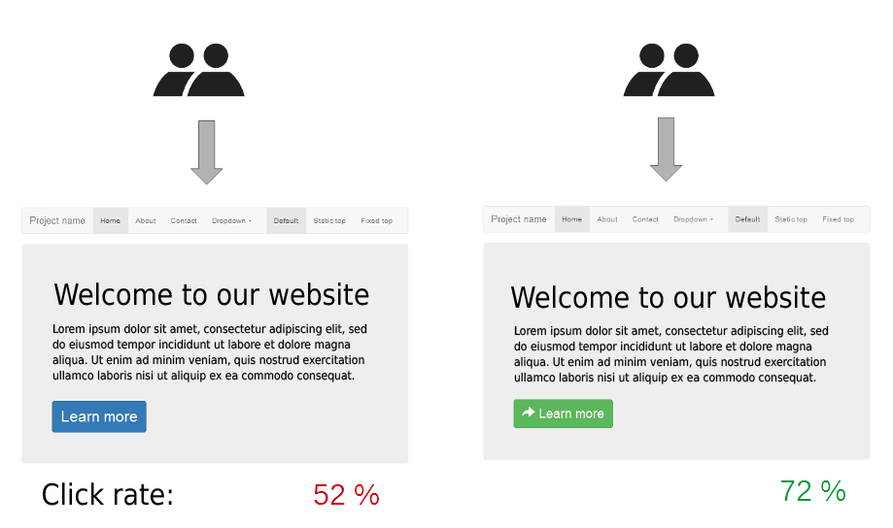
Production and Other Considerations
It is not sufficient to solve the problem once–we must set up recursive workflows.
At Twitter, refinements are assessed via A/B testing.

Slide 9
Summary: big data mining cycle.
Generated data
Sanity check & preprocess
Data mining
Adapt into production

Slide 10
What should academics care?
We suggest the most impactful research is not incrementally better data mining algorithms, but techniques to help data scientists “gork” the data.

Slide 11
Schemas and Beyond

Slide 12
Don’t use MySQL as a log
Too much written traffic in the user end
Scaling challenge
Database is designed for mutable data.
Evolving schemas and model is painful in database

Slide 13
The log transport problem
Twitter uses Scribe
Ascribe daemon runs on each production host and is responsible for sending local log data to the aggregator.
The aggregator merge per-category stream and send to HDFS.

Slide 14
The log transport problem
Within Twitter, data in the main Hadoop data warehouse are deposited in per-category, per-hour directories. (/logs/category/YYYY/MM/DD/HH)

Slide 15
From Plain Text to JSON
Problem: parsing plain-text log message is slow. Regular expression is also slow.
JSON is suitable for small enterprise.
Problem with JSON: userid? User_id? Uid?
Problem with JSON: int? double? String?

Slide 16
Structured representation
Twitter uses Apache Thrift to address the format of logged messages.
One benefits is that you can define the physical representation of the log by Thrift!

Slide 17
Looking beyond Schemas
A complete data catalog is needed!
HCataLog provides a basic table abstraction for files stored in HDFS.
The challenge occurs when we attempt to reconstruct user sessions. (need session tokens, which is usually not required by APIs).
“Client events” is an attempt to address the session issue.
Basic idea of “client events”: establish a Thrift schema for all data sharing the same fields.

Slide 18
Ad Hoc Data Mining
How to mine the huge data with limited resource? The traditional way is to feed the data batch by batch.
Problem: a batch of data may be too few for machine learning.
Traffic from Pig to machine learning software.
Approach used by Twitter: Integrating machine learning components into Pig.

