Slide 1
HERON

Slide 2
Motivation
Real time stream processing
Storm has drawbacks:
Scalability
Debug-ability
Performance
Easy to manage
Compatible with Storm’s current API

Slide 3
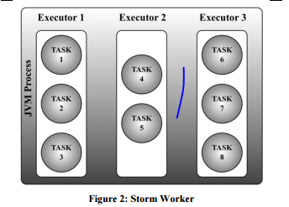
1.1 Strom worker architechture: limitations
Multi-level scheduling
-> Uncertainty of which tasks are being scheduled.
Impossible to isolate resource usage
-> Difficult to reason the behavior and performance.
Multiple tasks’ logs are written into the same file
-> Difficult to identify errors and exceptions.
-> 1 unhandled exception in a task takes down the entire worker -> low performance

Slide 4
1.1 Strom worker architechture: limitations
Storm assumes workers are homogeneous i.e. Over-provisionning
-> Low utilization of resources.
-> High allocation -> heap dump becomes awkward -> miss sending heartbeat signals
Prevent heap dump -> debugging becomes difficult.
Uses several threads to move data between tasks and workers
Totally 4 threads for each tuple to go through -> overhead and queue contention.

Slide 5
1.2 Nimbus: (schedule, monitor, distribute jars) overloaded
Workers belong to different topologies run on the same machine
Interfere with each other
Dedicate entire machines to 1 topology ? Utilization
Uses Zookeeper extensively to manage heartbeats
Zookeeper becomes the bottleneck.
Another daemon to manage heartbeats? More burden.
Nimbus fails:
not able to submit topologies nor kill
Topologies undergo failures cannot be detected.

Slide 6
1.3 Storm: Lack of backpressure
Fail-fast-> unpredictable behaviors.
1.4 Storm: Lack of efficiency in production
Replay entire tuple tree
Long garbage collection cycles
Queue contention

Slide 7
2. Design alternatives
Storm is fundamentally ill-implemented.
Other systems are not compatible with the Storm API.

Slide 8
3.1 Heron data model and API
Topologies
At most once / at least once semantics.

Slide 9
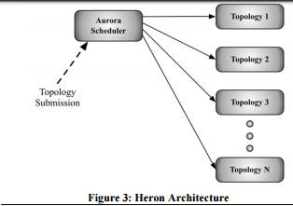
3.2 Heron Architecture
Aurora as the scheduler.

Slide 10
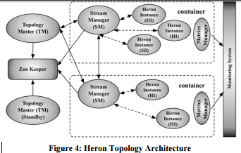
3.2 Heron Architecture
Aurora as the scheduler.
Allocate and schedule containers
HI (spout/bolt)
1 JVM/ Heron Instance
Each topology is run as an Aurora job consisting of several containers, as shown in Figure 4. The first container runs a process called the Topology Master. The remaining containers each run a Stream Manager, a Metrics Manager, and a number of HI

Slide 11
Topology Master
is responsible for managing the topology.
Gateway for topology metrics
Not involved in data processing, no bottleneck

Slide 12
Stream manager
Manage the routing of tuples
Send/ receive tuples from local HIs
Local HIs are short circuited

Slide 13
3.2 Spout Backpressure
SM realizes HIs are slowing down
-> identifies its local spouts and stops reading data from them
-> spout’s send get filled up -> eventually block.
The affected SM sends a special start backpressure message to other SMs.
Other SMs oblige by not reading tuples from their local spouts.
Once the slow HI catches up, the local SM sends stop backpressure messages to other SMs and start consuming data from their local spouts again.

Slide 14
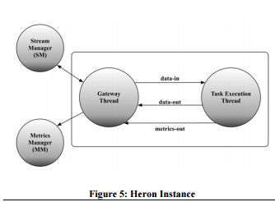
3.2 Spout Backpressure
Implementation
Buffer with high-low water mark.

Slide 15
3.3 Heron Instance
2-threaded approach
data-in queue exceeds bound
-> backpressure mechanism at the local SM.
data-out queue exceed the bound
-> task Execution thread should not emit or execute any more tuples.
A Task thread also collects metrics and sends to Gateway.
Avoid big GC issues: periodically check data queue capacities and reduce capacity or grow.

Slide 16
Metrics manager
Collects metrics from Stream Manager and HI
Send metrics to TM and Monitoring System

Slide 17
3.4 Start up sequence and failure scenarios
Aurora allocates resources and schedule topology containers.
TM comes up first
Stream managers consults ZK to discover TM.
Assign components to containers. (Physical plan)
Meanwhile HI comes up and discover their SM.
TM write physical plan to ZK

Slide 18
3.4 Start up sequence and failure scenarios
TM dies, recover from ZK. SM rediscover TM.
SM dies, restarted on the same container and rediscover TM.
Other SMs get a new copy of physical plan and connect
HI dies
Restart and gets a copy of physical plan from SM.
Container rescheduled / relocated
New SM discovers the TM and follows steps above.

Slide 19
3.4 Architecture SUmmary
Provisioning of resources is cleanly abstracted from cluster manager.
HI makes it easy to debug
Transparent monitoring on a topology
Avoid over provisioning
TMs make topologies independent of another
Back pressure leads to a consistent rate of delivering results.
No single point of failure.

Slide 20
Heron Tracker
Connects to ZK and discover TM to obtain metrics
Heron UI
Interact with topologies. Logical plan, physical plan, logs.
Heron Viz
Contacts Heron Tracker

Slide 21
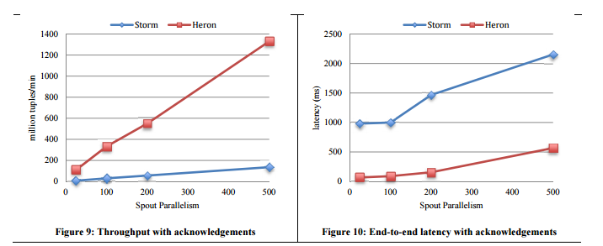
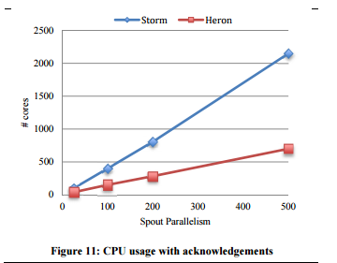
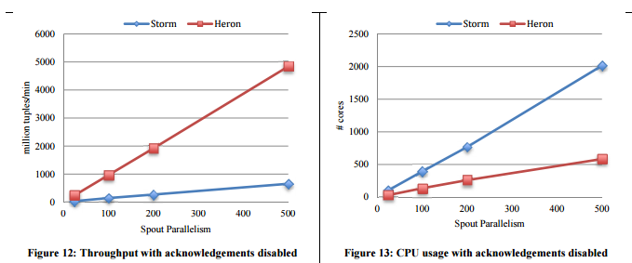
5. Evaluation

